Slide 1
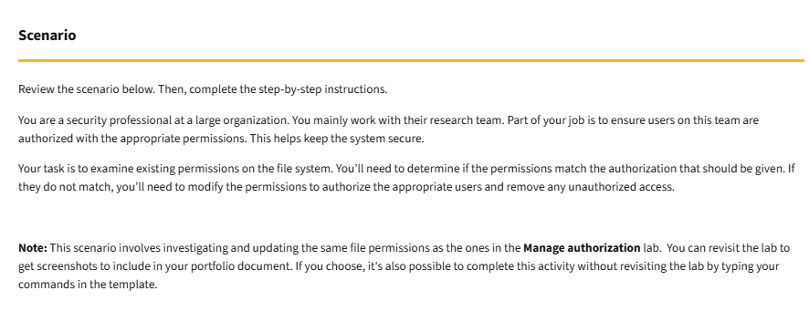
https://storage.googleapis.com/gwg-content/cybercert/Create%20a%20cybersecurity%20portfolio.pdf

Slide 2
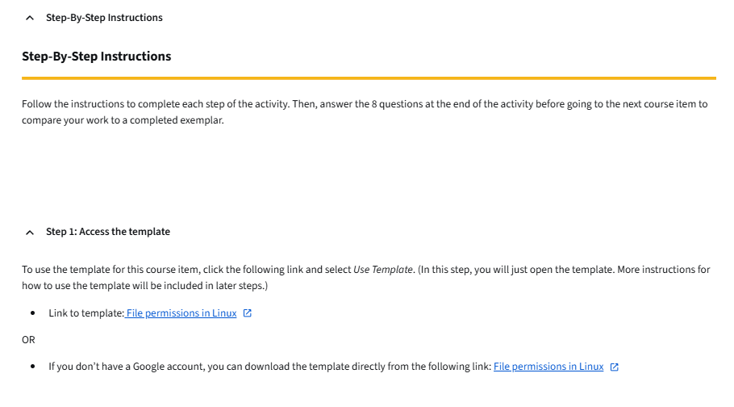
https://docs.google.com/document/d/1A3xiUi9wbXf5lGvRwm8oFsXq18Q8mP7FUDNndjj89zc/template/preview
https://storage.googleapis.com/gwg-content/cybercert/Create%20a%20cybersecurity%20portfolio.pdf

Slide 3
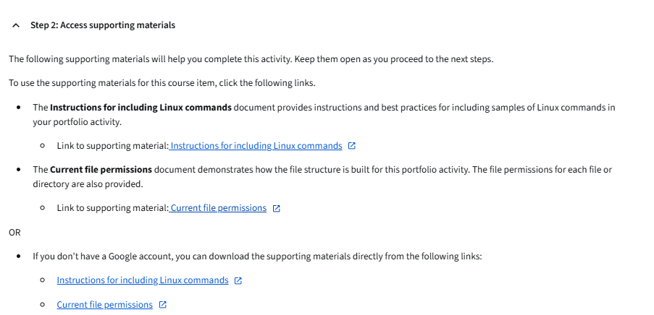
https://docs.google.com/document/d/1t-9o-bPndpOIh9577FJobiakS10kJxgIKrB6GG7EPwA/template/preview?resourcekey=0-623w2JztdmNSu3nDbsQJcQ
https://docs.google.com/document/d/1F3-8XQZsNagSzTkJwFzOGY5OHbGbMRtlb8GbmXE_gCc/template/preview?resourcekey=0-UUEu0EyFFvMf0SAipcel6w

Slide 4
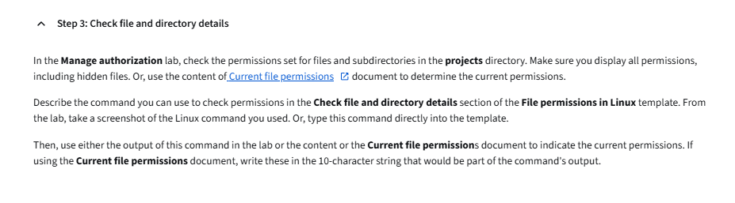
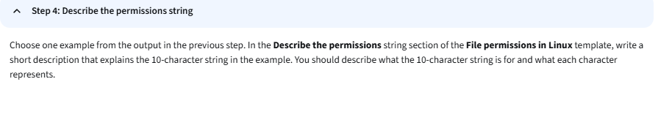
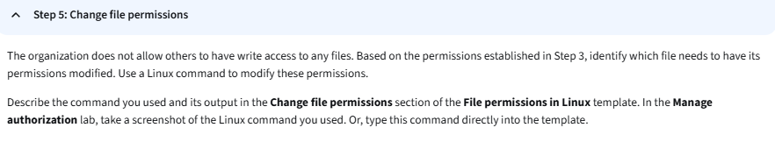
https://docs.google.com/document/d/1F3-8XQZsNagSzTkJwFzOGY5OHbGbMRtlb8GbmXE_gCc/template/preview?resourcekey=0-UUEu0EyFFvMf0SAipcel6w

Slide 5
